Slide 1
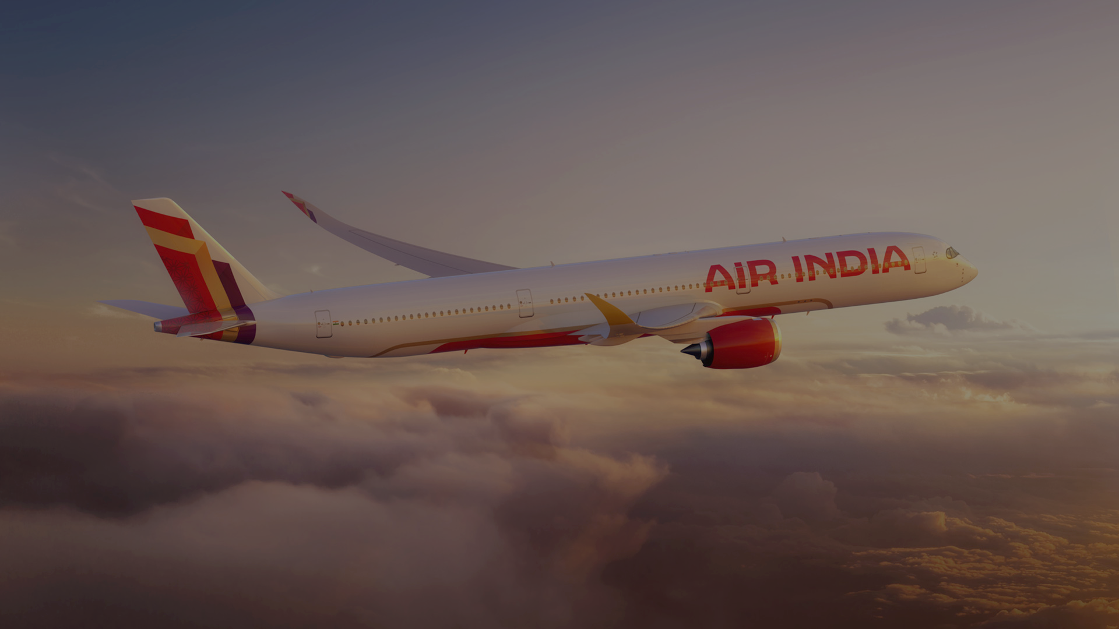
The Return of the Maharaja?
Sarah Lee
Rohan Giri
Agnitra Das
Saaket Joshi
Jyoti Kumari
Soham S. Bidyadhar

Slide 2
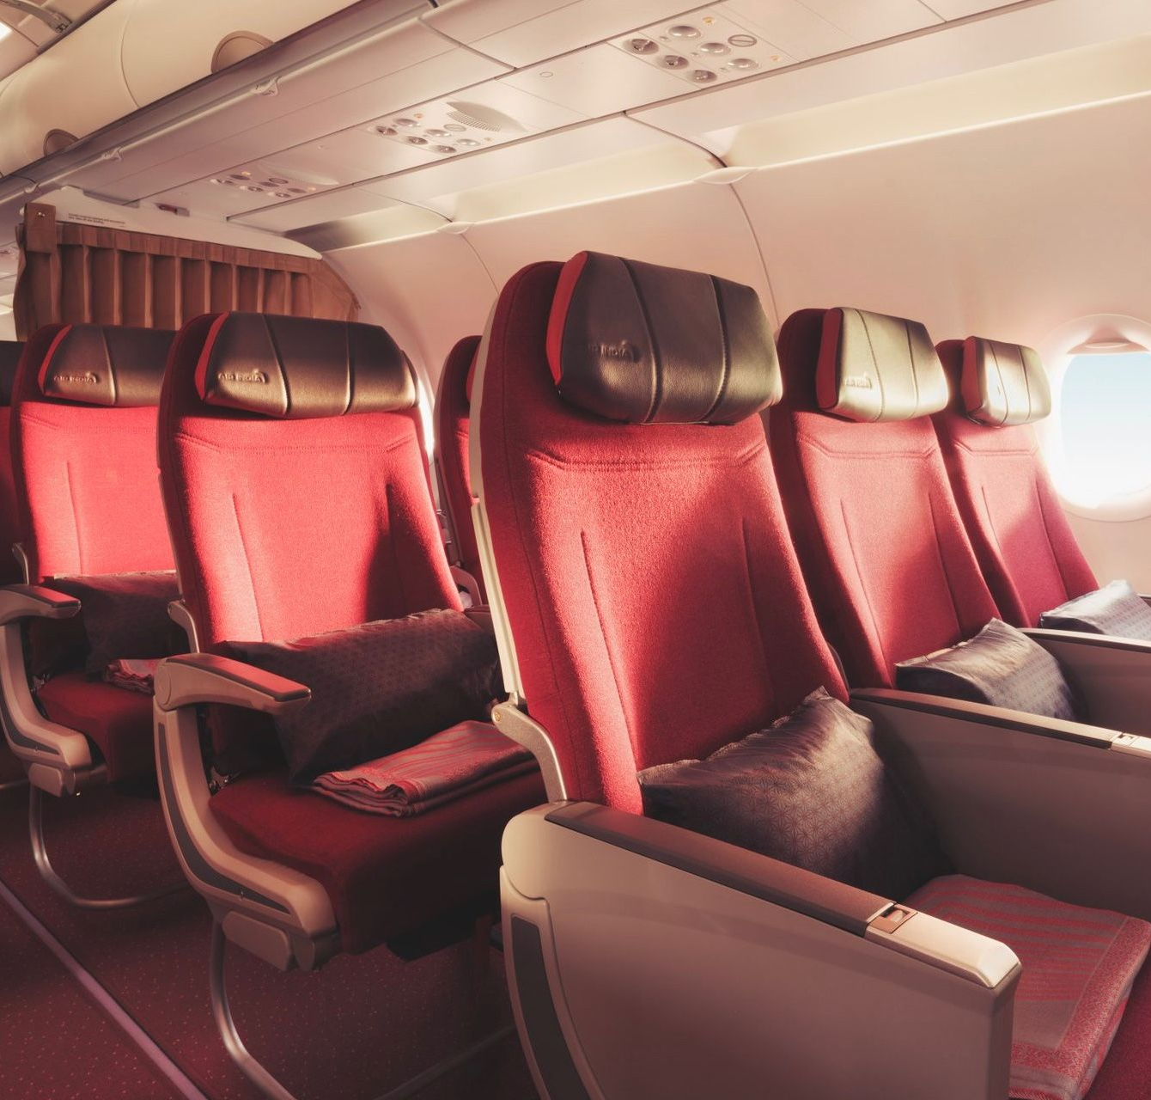
AGENDA
Business Overview
Business Problem
Data Scraping
Framework
Analysis
Conclusions

Slide 3
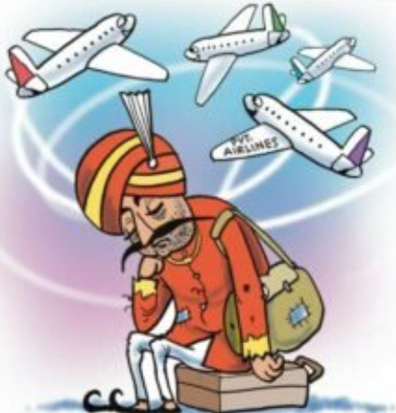

Business Overview
Pre-takeover Blues
Financial Trouble: Heavily in debt and losing money for years.
Operational Issues: Outdated planes, inefficient operations, overstaffed.
Poor Service: Reputation hurt by frequent delays and poor customer service.
Lagging behind Competition: Couldn't keep up with private Indian/international carriers.
As a result, the government saw selling Air India as the only way to save it from further decline.

Slide 4
Business Overview
Air India restructuring timeline
Tata Group reclaims Air India
Started leadership restructuring
Acquisition of AirAsia India
Vistara merger with Singapore Airlines
Vistara merger completion
Positioning Air India as a premium global airline
Jan ‘22
Mid ‘22
Nov ‘22
Feb ‘23
Mar ‘24
Launched Vihaan.AI, a 5-year turnaround plan
Fleet expansion with leased aircraft
Record order of 470 aircraft from Airbus and Boeing
$200M tech upgrade investment

Slide 5
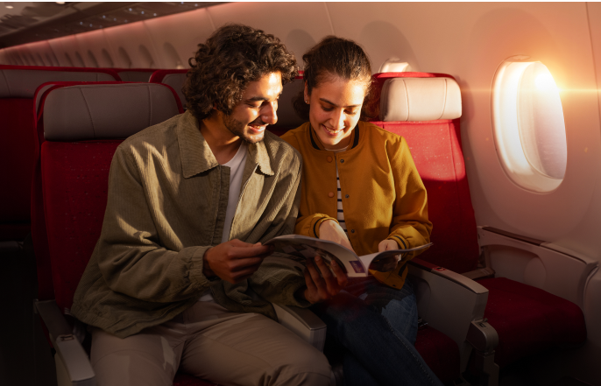
Business Problem
Post restructuring, is there an alignment with consumer perception?
Can we validate consumer perception of Air India using a data-driven approach to drive customer experience?

Slide 6

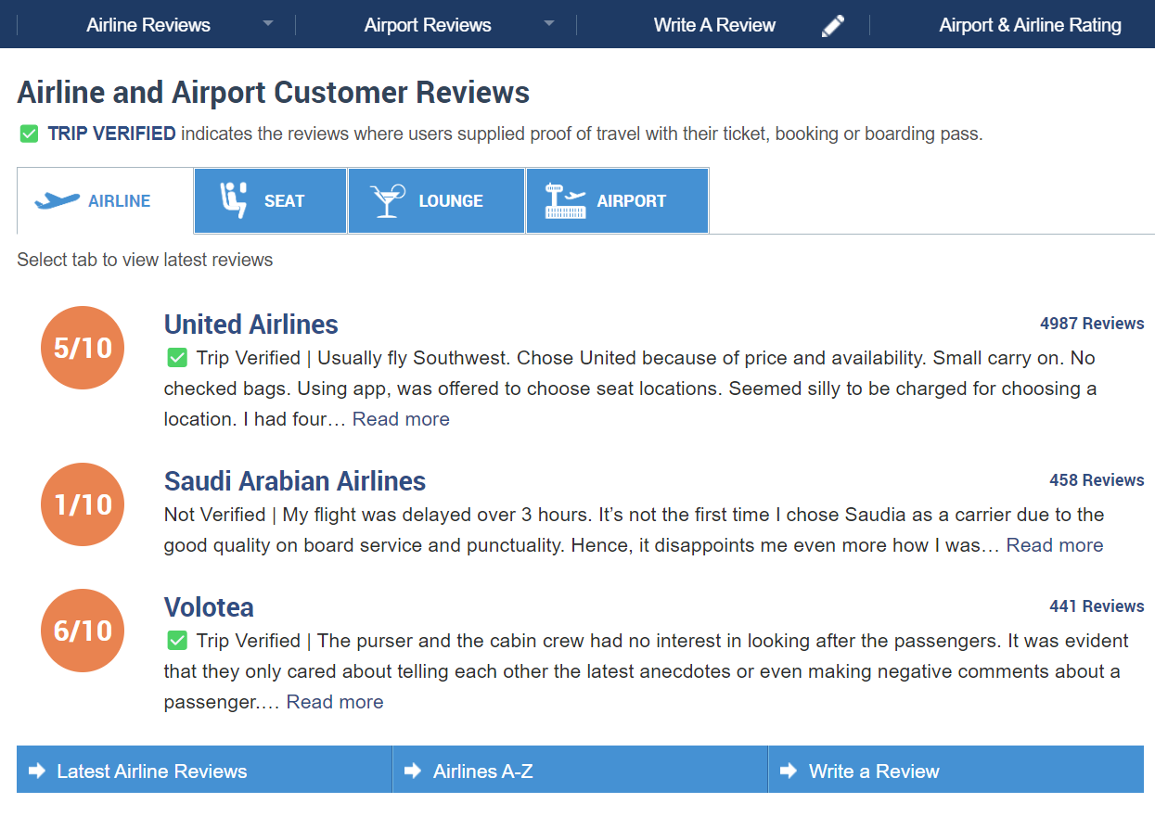
Data Scraping
Scraping methodology
Scraping website –
Skytrax reputed for airline and airport reviews
Scraping conducted using Selenium
~1500 reviews and user ratings scraped
Timeline - 2011 to 2024
Raw dataset cleaned
Removal of stopwords using nltk
String preprocessing using regular expressions

Slide 7
Framework
Methodology
Framework used
Derived Analysis
Pre-defined attribute mapping
Word Frequency
Count
Attribute composition contribution
Mapped most frequent words into 7 key attributes
Top 100 most frequently mentioned words
Compared changes in specific attributes
Sentiment Analysis (VADER)
Time Series Analysis
Measured positive/negative sentiments
Tracked pre and post takeover sentiments

Slide 8
Framework
Attribute mapping
Attributes
Seating
Flight Punctuality
Dining
Luggage Handling
Entertainment
Service
Legroom
Seats
Comfort
Time
Delay
Late
Food
Vegetarian
Meal
Luggage
Lost
Bags
Screen
Movies
Cinematic
Staff
Crew
Service
Mapped words

Slide 9
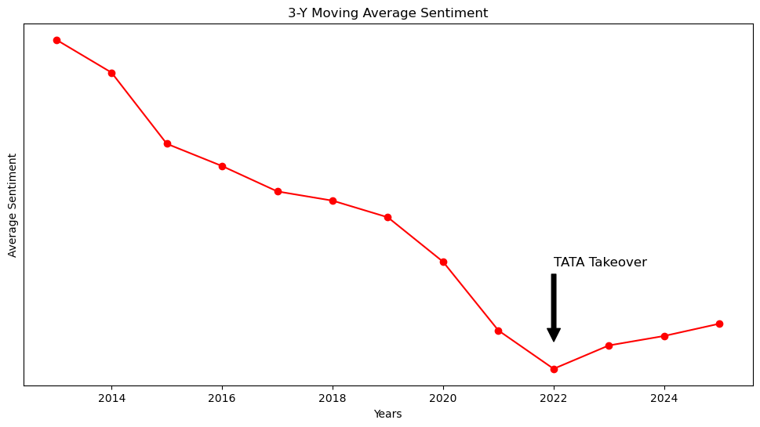
Analysis
Time Series Analysis - Sentiment
3-Year Moving Average Sentiment time series
Key Insights
Steady decline in sentiment from 2013 to 2022, suggesting gradual deterioration in customer perception and satisfaction
Noticeable improvement in sentiments post-TATA takeover indicating potential positive changes recognized by customers
These improvements likely reflect early efforts by management to enhance service quality and operational efficiency

Slide 10
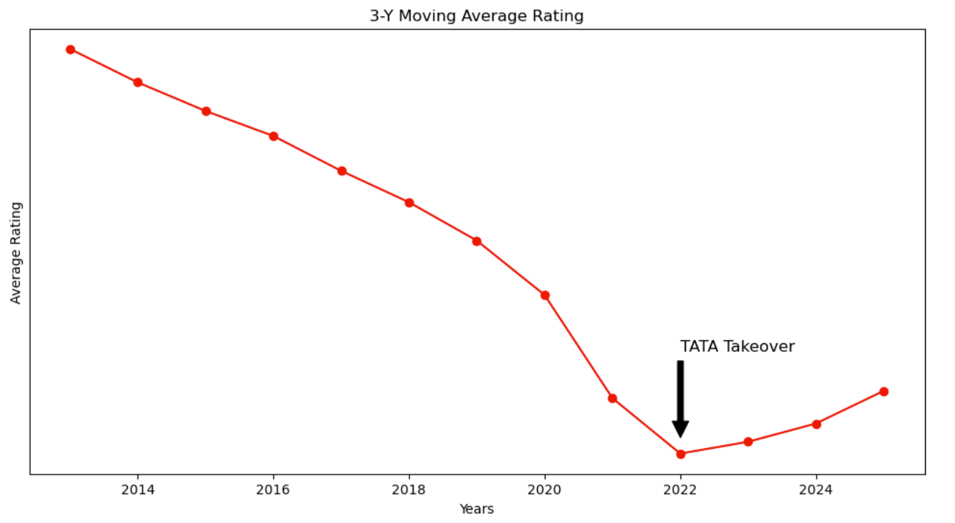
Analysis
Time Series Analysis - Ratings
3-Year Moving Average Rating time series
Key Insights
Steady decline in ratings from 2013 to 2022, suggesting increasing customer dissatisfaction.
Noticeable improvement in ratings post-TATA takeover, indicating potential positive changes in customer satisfaction.
These improvements likely reflect early efforts by management to enhance service quality and operational efficiency.

Slide 11
Analysis
Attribute composition analysis
Top attribute mentions among negative sentiment reviews-
Key Insights
Pre-takeover & Post-takeover, service had the most number of mentions, making it a key driver for customer experience
Rise in entertainment (15% increase) related mentions post-takeover suggests its importance as a growing aspect of the overall customer experience
Dip in dining (20% decrease) mentions post-takeover indicating possible shift in customer focus or priorities
Frequency ranking
1
2
3
* Following attributes selected are within top 100-word frequency

Slide 12



Diving deeper
Major Issues – Pre takeover
Rude staff behavior
Improper hygiene
Lack of communication regarding flight delays
Inadequate support for passengers with special needs
Poor baggage handling
Refund for cancelled trips and lost baggage taking months
“…There was no announcement or notification about the delay until we had already been waiting for over an hour."
Service
Poor quality of food served
Lack of options for long-haul flights
Long-haul flights often experiencing meal shortages
“…The meal options were very limited, and they ran out of non-veg options before reaching our row."
Dining
Lack of screens for long-haul flights
Unclean headphones, broken screens and remotes
Staff unable to troubleshoot malfunctioning
“…My screen was broken, and the flight attendant couldn’t do anything about it, leaving me without entertainment for the whole journey."
IFE

Slide 13
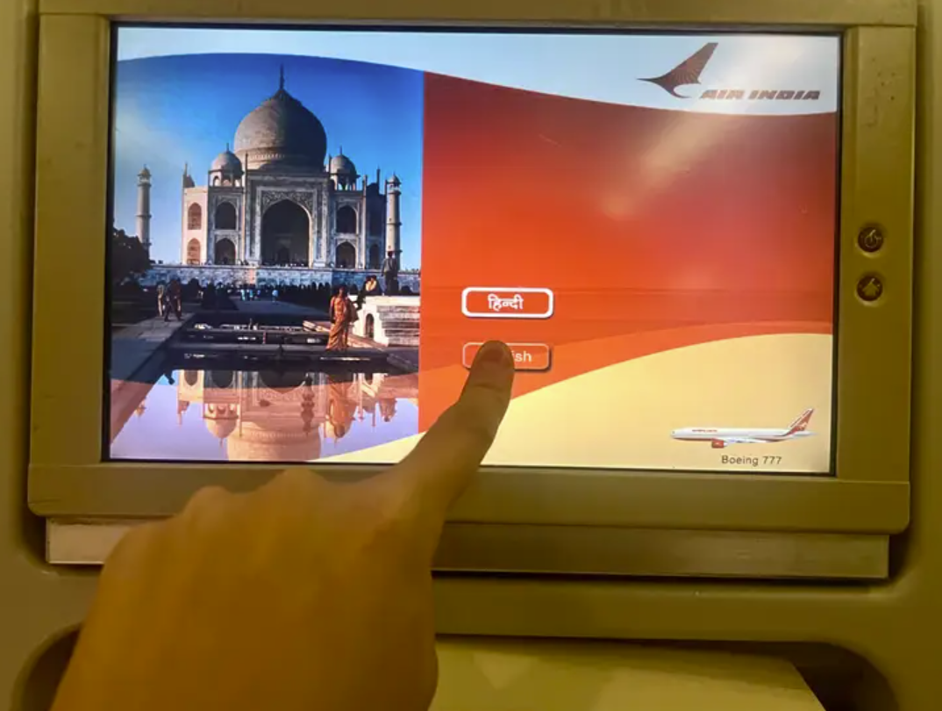
Diving deeper
Improvements – Post takeover
Polite, attentive, and professional staff
Proactive in helping passengers, especially elderly and special-needs cases
Refurbished interiors and improved restroom maintenance
Proactive updates on delays and better transparency
Service
Flavorful meals with larger portions
Use of steel cutlery enhances premium feel
Dining
Still need to work on…
In-Flight Entertainment
Some passengers still report non-functioning or outdated screens
Timeliness
While communication is better, flight delays remain common
Aging Fleet
Cabin interiors show signs of wear; fleet refurbishment still in progress
Notes:
Image source - https://i.insider.com/65ce3112f533b039a883f597?width=750&format=jpeg&auto=webp

Slide 14
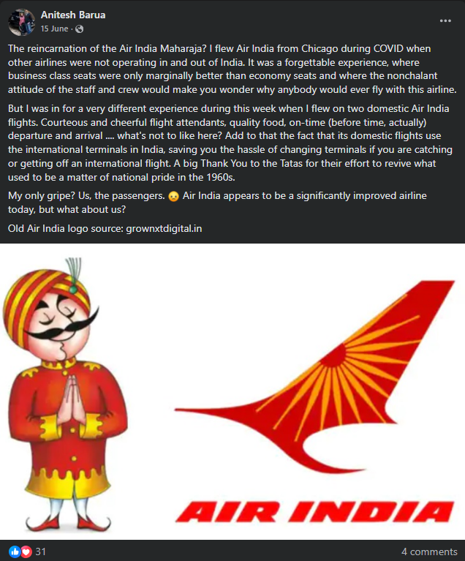
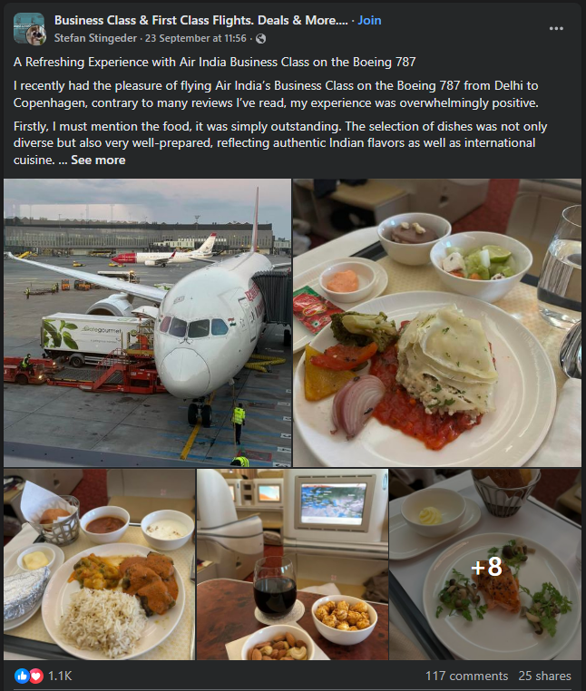
Analysis
External Analysis 1 – Customer sentiment post takeover
Source: Facebook

Slide 15
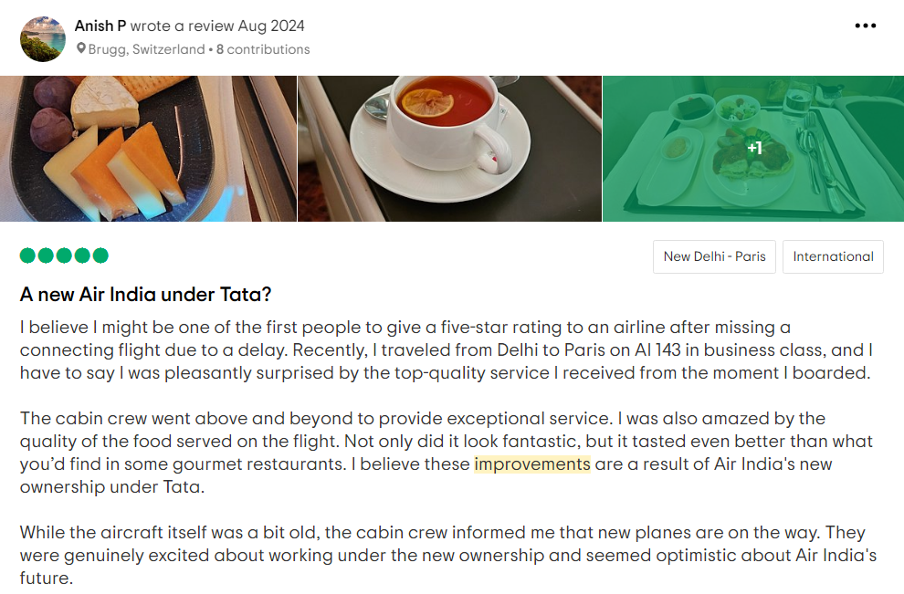
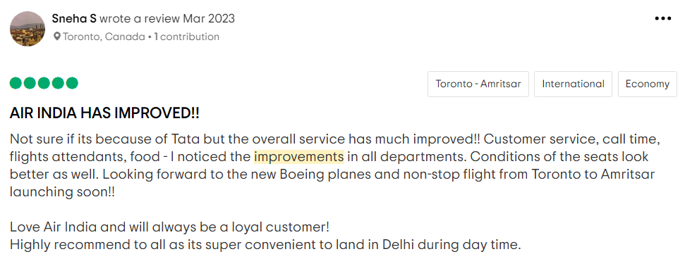
Analysis
External Analysis 2 – Customer sentiment post takeover
Source: Trip Advisor

Slide 16
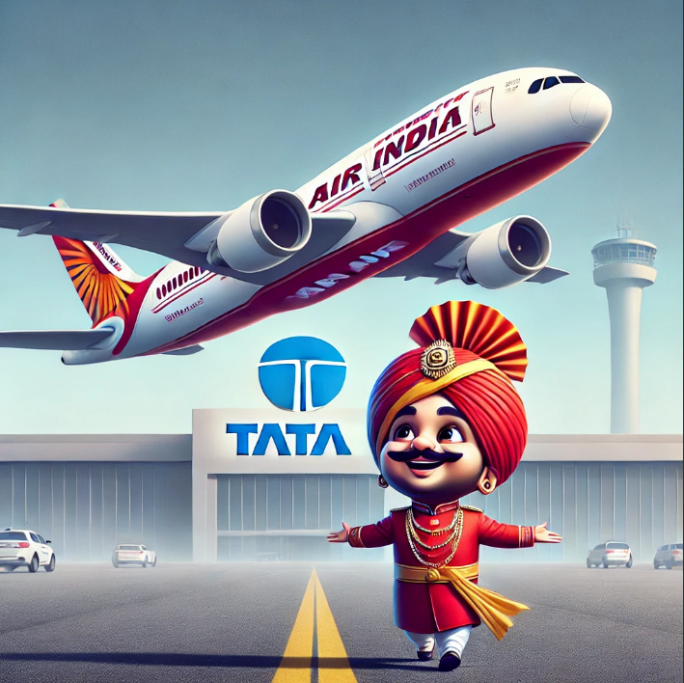
Conclusions
Upward trajectory in overall customer sentiment post-takeover: Sentiment analysis suggest noticeable improvement in customer experience
Enhancing dining, service, entertainment capabilities: Dining, Entertainment, Service-related mentions had the highest frequency indicating important aspects contributing towards positive customer experience
Leveraging positive sentiment for brand building: Posts from other forums such as Facebook, Trip Advisor validate positive customer sentiment thus presenting opportunities to further capitalize brand building
Future work and scope: Expand sentiment analysis beyond the initial 2-year period; Exploring positive/negative sentiments by attribute when more data is available

Slide 17
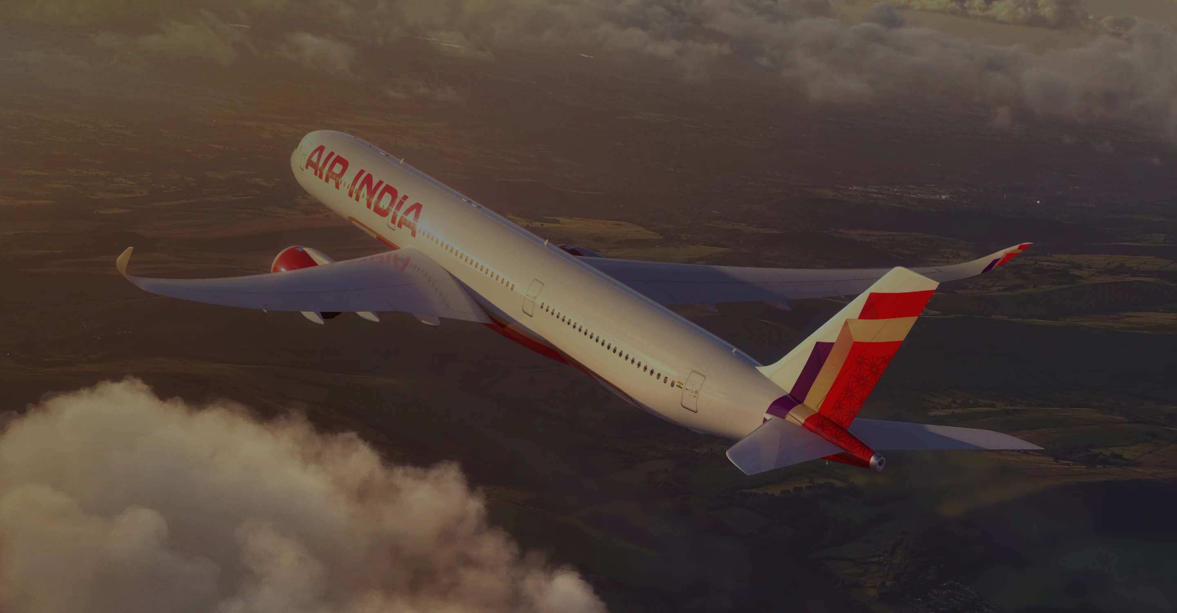
THANK YOU!
Any Questions?

